Slide 1
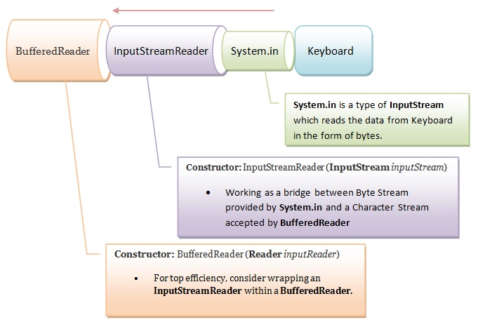
Java InputStreamReader – Read from Keyboard

